Slide 1
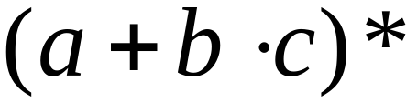
Regular Expressions
Regular expressions describe regular languages
Example:
describes the language
Courtesy Costas Busch - RPI

Slide 2
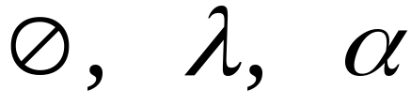



Recursive Definition
Primitive regular expressions:
Given regular expressions and
Are regular expressions
Courtesy Costas Busch - RPI

Slide 3
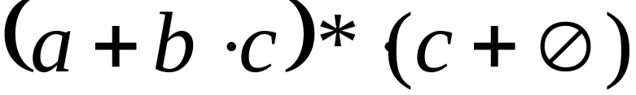
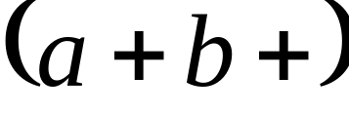
Examples
A regular expression:
Not a regular expression:
Courtesy Costas Busch - RPI

Slide 4
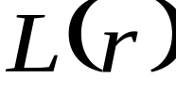

Languages of Regular Expressions
: language of regular expression
Example
Courtesy Costas Busch - RPI

Slide 5
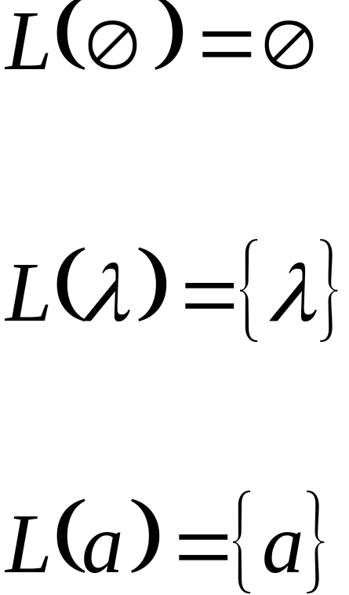
Definition
For primitive regular expressions:
Courtesy Costas Busch - RPI

Slide 6




Definition (continued)
For regular expressions and
Courtesy Costas Busch - RPI

Slide 7






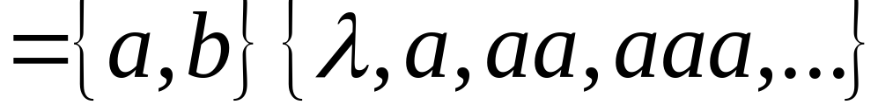
Example
Regular expression:
Courtesy Costas Busch - RPI

Slide 8

Example
Regular expression
Courtesy Costas Busch - RPI

Slide 9


Example
Regular expression
Courtesy Costas Busch - RPI

Slide 10


Example
Regular expression
= { all strings with at least two consecutive 0 }
Courtesy Costas Busch - RPI

Slide 11
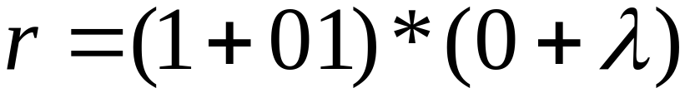
Example
Regular expression
= { all strings without two consecutive 0 }
Courtesy Costas Busch - RPI

Slide 12

Equivalent Regular Expressions
Definition:
Regular expressions and
are equivalent if
Courtesy Costas Busch - RPI

Slide 13

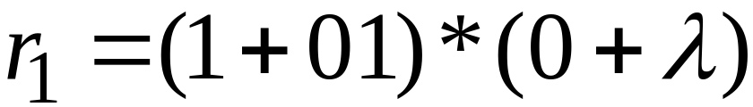

Example
= { all strings without two consecutive 0 }
and
are equivalent
regular expr.
Courtesy Costas Busch - RPI

Slide 14
Task
Q)
Let S={ab, bb} and T={ab, bb, bbbb} Show
that S* = T* [Hint S* ⊆ T* and T* ⊆ S*]
2) Let S={ab, bb} and T={ab, bb, bbb} Show that S* ≠ T* But S* ⊂ T*
Solution: Since S ⊂ T , so every string belonging to S* , also belongs to T* but bbb is a string belongs to T* but does not belong to S*.

Slide 15
3) Let S={a, bb, bab, abaab} be a set of strings. Are abbabaabab and baabbbabbaabb in S*? Does any word in S* have odd number of b’s?
Solution: since abbabaabab can be grouped as (a)(bb)(abaab)ab , which shows that the last member of the group does not belong to S, so abbabaabab is not in S*, while baabbbabbaabb can not be grouped as members of S, hence baabbbabbaabb is not in S*. Since each string in S has even number of b’s so there is no possiblity of any string with odd number of b’s to be in S*.

Slide 16
Task
Q1)Is there any case when S⁺ contains Λ? If yes then justify your answer.
Solution: consider S={Λ,a} then
S⁺ ={Λ, a, aa, aaa, …}
Here Λ is in S⁺ as member of S. Thus Λ will be in S⁺ , in this case.

Slide 17
Q2) Prove that for any set of strings S
(S⁺)*=(S*)*
Solution: In general Λ is not in S⁺ , while Λ does belong to S*. Obviously Λ will now be in (S⁺)*, while (S*)* and S* generate the same set of strings. Hence (S⁺)*=(S*)*.

Slide 18
Q2) continued…
ii) (S⁺)⁺=S⁺
Solution: since S⁺ generates all possible strings that can be obtained by concatenating the strings of S, so (S⁺)⁺ generates all possible strings that can be obtained by concatenating the strings of S⁺ , will not generate any new string.
Hence (S⁺)⁺=S⁺

Slide 19
Q2) continued…
Is (S*)⁺=(S⁺)*
Solution: since Λ belongs to S* ,so Λ will belong to (S*)⁺ as member of S* .Moreover Λ may not belong to S⁺, in general, while Λ will automatically belong to (S⁺)*.
Hence (S*)⁺=(S⁺)*

Slide 20
Regular Expression
As discussed earlier that a* generates
Λ, a, aa, aaa, …
and a⁺ generates a, aa, aaa, aaaa, …, so the language L₁ = {Λ, a, aa, aaa, …} and L₂ = {a, aa, aaa, aaaa, …} can simply be expressed by a* and a⁺, respectively.
a* and a⁺ are called the regular expressions (RE) for L₁ and L₂ respectively.
Note: a⁺, aa* and a*a generate L₂.

Slide 21
Recursive definition of Regular Expression(RE)
Step 1: Every letter of Σ including Λ is a regular expression.
Step 2: If r₁ and r2 are regular expressions then
  (r₁)
  r₁ r₂
  r₁ + r₂ and
  r₁*
  are also regular expressions.
Step 3: Nothing else is a regular expression.

Slide 22
Defining Languages (continued)…
Method 3 (Regular Expressions)
  Consider the language L={Λ, x, xx, xxx,…} of strings, defined over Σ = {x}.
  We can write this language as the Kleene star closure of alphabet Σ or L=Σ*={x}*
  this language can also be expressed by the regular expression x*.
  Similarly the language L={x, xx, xxx,…}, defined over Σ = {x}, can be expressed by the regular expression x⁺.

Slide 23
  Now consider another language L, consisting of all possible strings, defined over Σ = {a, b}. This language can also be expressed by the regular expression
  (a + b)*.
  Now consider another language L, of strings having exactly double a, defined over Σ = {a, b}, then it’s regular expression may be
  b*aab*

Slide 24
  Now consider another language L, of even length, defined over Σ = {a, b}, then it’s regular expression may be
  ((a+b)(a+b))*
  Now consider another language L, of odd length, defined over Σ = {a, b}, then it’s regular expression may be
  (a+b)((a+b)(a+b))* or
  ((a+b)(a+b))*(a+b)

Slide 25
Remark
It may be noted that a language may be expressed by more than one regular expressions, while given a regular expression there exist a unique language generated by that regular expression.

Slide 26
Example:
  Consider the language, defined over
  Σ={a , b} of words having at least one a, may be expressed by a regular expression
  (a+b)*a(a+b)*.
  Consider the language, defined over
  Σ = {a, b} of words having at least one a and one b, may be expressed by a regular expression
  (a+b)*a(a+b)*b(a+b)*+ (a+b)*b(a+b)*a(a+b)*.

Slide 27
  Consider the language, defined over
  Σ={a, b}, of words starting with double a and ending in double b then its regular expression may be aa(a+b)*bb
  Consider the language, defined over
  Σ={a, b} of words starting with a and ending in b OR starting with b and ending in a, then its regular expression may be a(a+b)*b+b(a+b)*a

Slide 28
TASK
  Consider the language, defined over
  Σ={a, b} of words beginning with a, then its regular expression may be a(a+b)*
  Consider the language, defined over
  Σ={a, b} of words beginning and ending in same letter, then its regular expression may be (a+b)+a(a+b)*a+b(a+b)*b

Slide 29
TASK
  Consider the language, defined over
  Σ={a, b} of words ending in b, then its regular expression may be (a+b)*b.
  Consider the language, defined over
  Σ={a, b} of words not ending in a, then its regular expression may be (a+b)*b + Λ. It is to be noted that this language may also be expressed by ((a+b)*b)*.

Slide 30


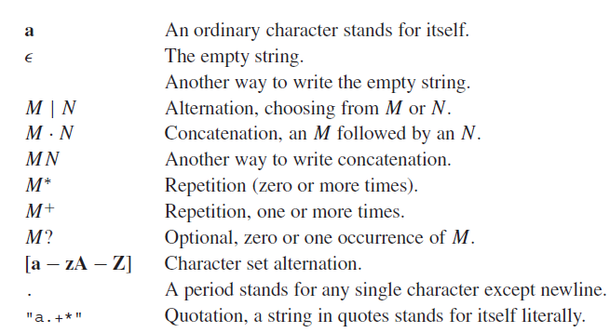
More Practical RE Examples

Slide 31
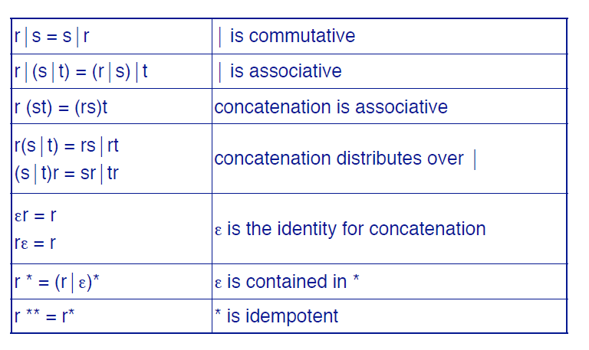
Algebraic Properties

Slide 32
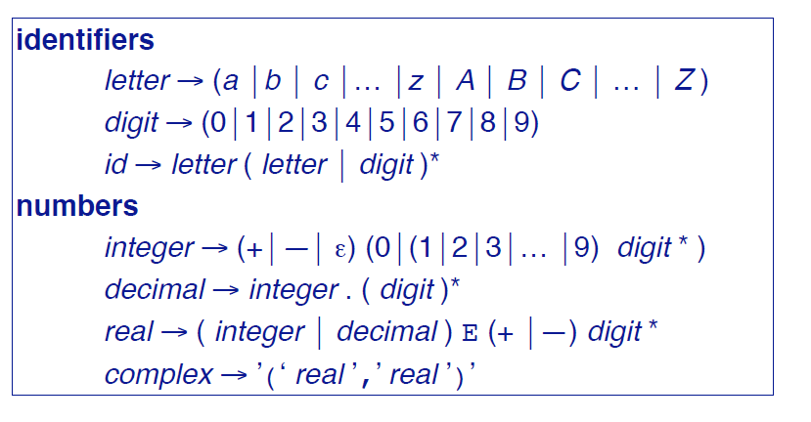
Using R.E for Tokenization

Slide 33
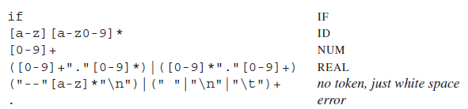
R.E. and Tokens – Our job
Assign a token type to a subset of input stream, based on its matching with a RE
The fifth line recognizes comments or white space but does not report back to the parser.
White space is discarded and the lexer resumed.
The comments for this lexer begin with two dashes, contain only alphabetic characters, and end with newline.

Slide 34
SummingUP Lecture 2
RE, Recursive definition of RE, defining languages by RE, { x}*, { x}⁺, {a+b}*, Language of strings having exactly one aa, Language of strings of even length, Language of strings of odd length, RE defines unique language (as Remark), Language of strings having at least one a, Language of strings havgin at least one a and one b, Language of strings starting with aa and ending in bb, Language of strings starting with and ending in different letters.

